Slide 1


UNDERSTANDING ANGULAR
T. Sathvika Reddy
22H51A05T1
CSE-D

Slide 2


Understanding the Angular Framework
Component-Based Architecture
Data Binding
Angular facilitates seamless data synchronization between components and the user interface, ensuring a dynamic and responsive user experience.
Angular applications are built using reusable components, which encapsulate functionality and structure, promoting code modularity and maintainability.
Dependency Injection
Modules and Routing
Angular's dependency injection system enables components to request and receive services, promoting code reusability and testability.
Angular's modular structure allows developers to organize code into logical units, while its routing system enables navigation between different parts of the application.

Slide 3
Angular's Role in the Full Stack
Front-End Development
Back-End Integration
Data Management
Angular is primarily used for building front-end web applications, providing a robust framework for creating user interfaces, managing data, and handling user interactions.
Angular seamlessly integrates with back-end systems through RESTful APIs, enabling communication between the front-end and back-end services.
Angular utilizes services like RxJS to manage data flow, handle asynchronous operations, and ensure efficient data handling across the application.

Slide 4

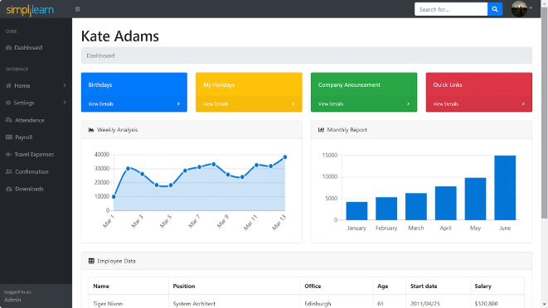
Setting up an Angular Development Environment
1
Install Node.js and npm
Node.js provides the runtime environment, while npm (Node Package Manager) manages project dependencies.
2
Install the Angular CLI
The Angular CLI (Command Line Interface) simplifies project creation, development, and deployment.
3
Create a New Project
The Angular CLI provides a command to create a new Angular project with pre-configured files and dependencies.
4
Run the Development Server
The Angular CLI includes a development server that automatically builds and serves the application for testing and debugging.

Slide 5

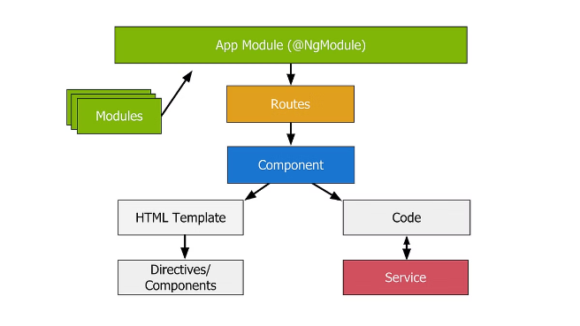
Angular Components and Templates
1
Components
2
Templates
Components are building blocks of an Angular application. They encapsulate view logic, data, and behavior, promoting code reuse and maintainability.
Templates define the visual structure of components, using Angular's templating syntax to bind data and logic to the HTML elements.
3
Data Binding
4
Directives
Angular provides various data binding mechanisms, including interpolation, property binding, event binding, and two-way binding, enabling dynamic updates between the component and the template.
Directives are special instructions that extend HTML's capabilities. Angular provides built-in directives for common tasks like structural directives (e.g., *ngIf, *ngFor) and attribute directives (e.g., ngClass, ngStyle).

Slide 6


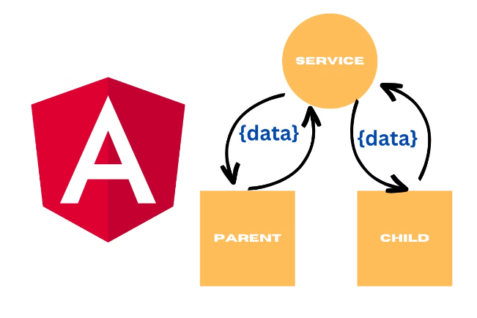


Angular Services and Dependency Injection
Services
Services are reusable classes that encapsulate logic and data that are shared across multiple components.
Dependency Injection
Dependency injection is a core principle in Angular. It enables components to request and receive services, promoting code reusability and testability.
Service Providers
Service providers are responsible for creating and managing the lifecycle of services, ensuring that they are available to components that require them.

Slide 7

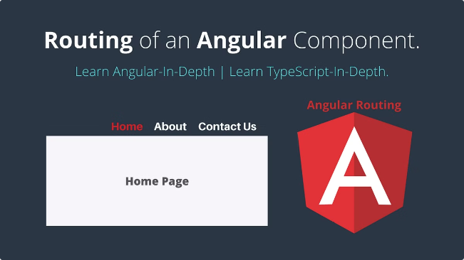
Angular Routing and Navigation
RouterModule
Provides routing capabilities and defines navigation routes.
Routes
Define the URL paths and corresponding components that are displayed.
RouterLink Directive
Creates clickable links that navigate to specific routes.
ActivatedRoute
Provides information about the current route and its parameters.
RouterOutlet Directive
Defines the place in the template where the routed component is displayed.

Slide 8

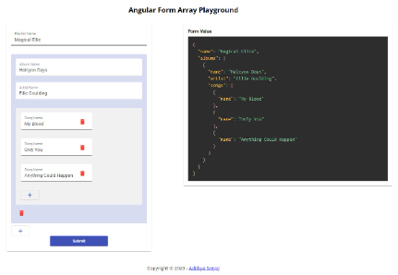




Angular Forms and Validation
Template-Driven Forms
Reactive Forms
Validation
Custom Validation
Use a data-driven approach with a form model to manage form state and validation.
Angular provides built-in validation mechanisms to ensure data integrity and prevent invalid inputs.
Create custom validation logic to enforce specific business rules and data constraints.
Use HTML attributes and directives to create forms and manage user input.

Slide 9
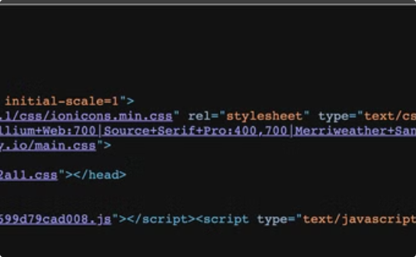
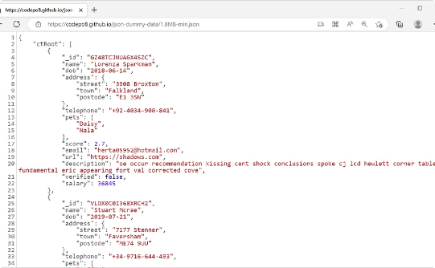
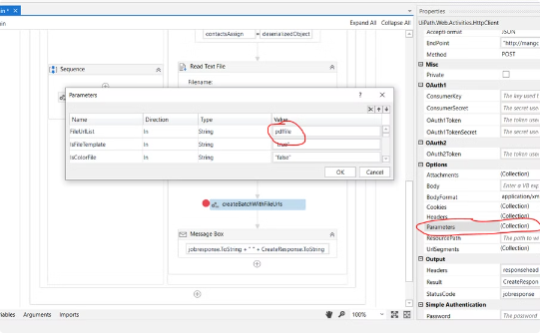
Angular and RESTful APIs
HttpClient Service
Data Fetching
Data Submission
Angular's HttpClient service facilitates communication with RESTful APIs.
Use the HttpClient to send HTTP requests to retrieve data from back-end services.
Submit data to back-end services using the HttpClient to save or update data.

Slide 10

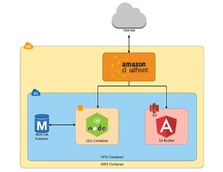
Deploying an Angular Application
Build the Application
Deploy the Built Files
The Angular CLI provides a command to build the application, creating optimized production bundles.
Upload the built application files to the chosen hosting platform.
1
2
3
4
Choose a Hosting Platform
Configure the Application
Options include cloud platforms (AWS, Azure, Google Cloud), static hosting providers, or custom servers.
Depending on the hosting platform, configure settings like domain names, environment variables, and security measures.

Slide 11
THANK YOU

